Slide 1

TED Talk Marketing
Modeling to predict the factors to successful TED talk videos
Team 1-08
Jessie Gong | Mona Noori-Moghaddam | Jeffrey Townsend | Hai Wang

Slide 2
Agenda
INTRODUCTION
THE PROBLEM
DATA PREPARATION
MODEL BUILDING
THE RESULTS
An overview of the problem our model will attempt to solve
Where we found reliable data and how we prepped it
How we developed our model and challenges we faced along the way
An assessment of the model’s accuracy and overall success

Slide 3

The Goal of TED Talks
To foster spread of great ideas. It aims to provide a platform for thinkers, visionaries, and teachers so that people around the globe can gain a better understanding of the biggest issues in the world and feed a desire to create a better future
Who We Are
We represent the TED marketing team
Our mission is to increase the traffic to Ted Talks by using funds wisely in promotions
Notes:
Ted Talks deliver ideas worth sharing
Ted Talks functions on donations, so produce output that responds to donors
Since ted is a conference we want to increase traffic to the conference as well as sponsporships to continue with the nonprofit and be able to share the videos online
need to be responsible for Sapling Foundation

Slide 4



TED Talk Database
DATA PREPARATION
Kaggle Data
Kaggle is a platform for predictive modelling and analytics competitions in which statisticians and data miners compete to produce the best models for predicting and describing the datasets uploaded by companies and users.
DATA CHARACTERISTICS
Comprehensive information about each TED talk, including views, ratings, along with video features
A full script of each TED talk
TIMEFRAME
Contains data from 1972 – September 2017

Slide 5
DATA PREPARATION

Slide 6
1972
The starting point of TED dataset
2000
There is a large increase in the number of videos since 2000, and therefore our model utilizes data from 2000 on
September 2017

Slide 7
Cleaning the Data
DATA PREPARATION
Extract top 14 ratings and classify into “good” or “bad”
good = ['Funny', 'Beautiful', 'Ingenious', 'Courageous', 'Informative', 'Fascinating’,
'Persuasive', 'Jaw-dropping', 'Inspiring']
bad = ['Longwinded', 'Confusing', 'Unconvincing', 'OK', 'Obnoxious']
Python
MySQL
Count unique tags and good/bad ratings for each video

Slide 8
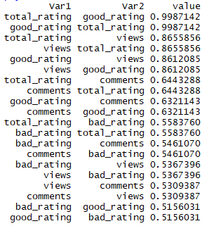
Variable Selection
MODEL BUILDING
Filtered by correlation between 0.5 and 1
Good ratings are highly correlated with views
→ Major predictor
Good ratings and total ratings are almost perfectly correlated
→ Total ratings and percentages are not
necessary for analysis
Correlation matrix
Notes:
To see the correlations between all columns
Views → y → we need to keep those
Good&bad not too high → kept both

Slide 9
Cleaning the Data
DATA PREPARATION
Keep a count of good and bad ratings for each video
Keep the count of main tags for each video
Trim the data down to 6 predictors
The number of views is what we try to predict
Notes:
Which are comments, duration, languages, number of tags, good ratings, and bad ratings

Slide 10
MODEL BUILDING

Slide 11

Objective
MODEL BUILDING
CORRECTNESS
TYPE 1 ERROR
TYPE 2 ERROR
GOAL
GOAL
GOAL
To maximize the percentage of times the model will produce an overall correct result
To minimize when the model says the video would get a large number of views when it does not
To minimize when the model says that the video would not get many views when it does
ERROR PRIORITY
We developed our model to prioritize minimizing MSE and Type 1 Error in classification setting

Slide 12
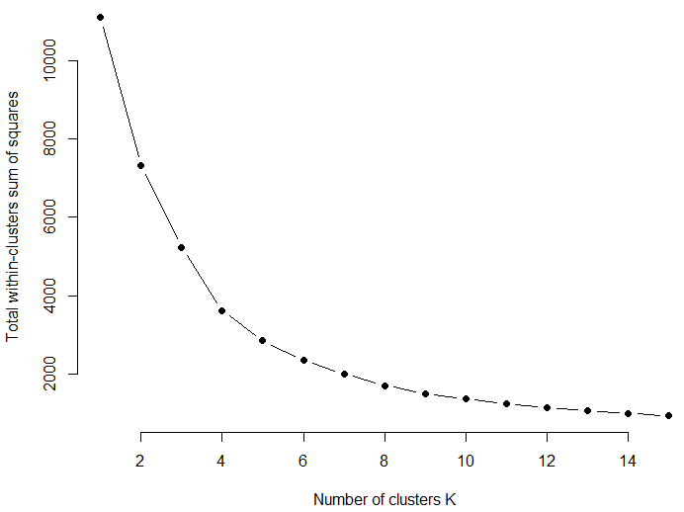
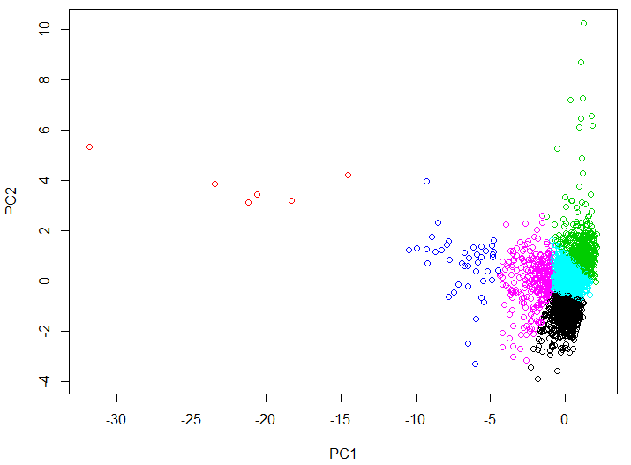
K-Means Clustering w/PCA
MODEL BUILDING
Run PCA to reduce the dimensions, then use k-means on the first 2 principle components.
Calculating optimal K
K-Means when K=6
Notes:
For PC1, it’s negatively correlated with comments, languages, views and both ratings
PC2 is most strongly correlated with duration and tags and negatively correlated with languages
The more PC1, the less comments, languages, views and both ratings
More views to the left
Goal: Visualize all dimensions in 2 dimensions, easier to see

Slide 13
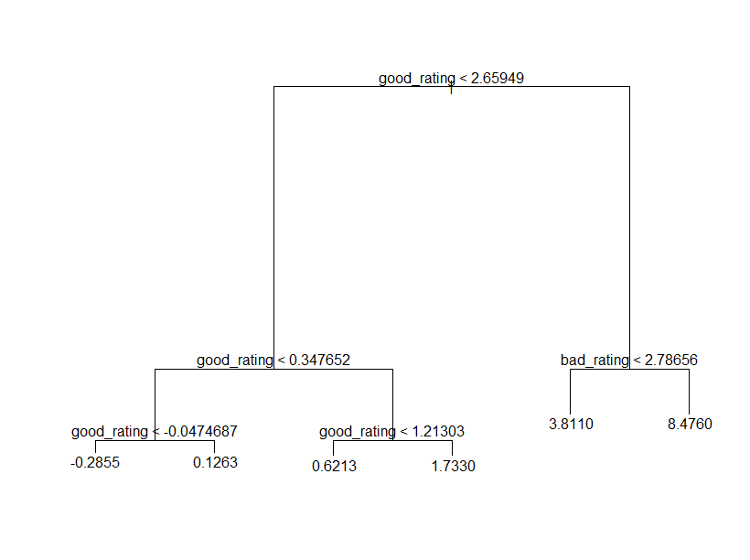
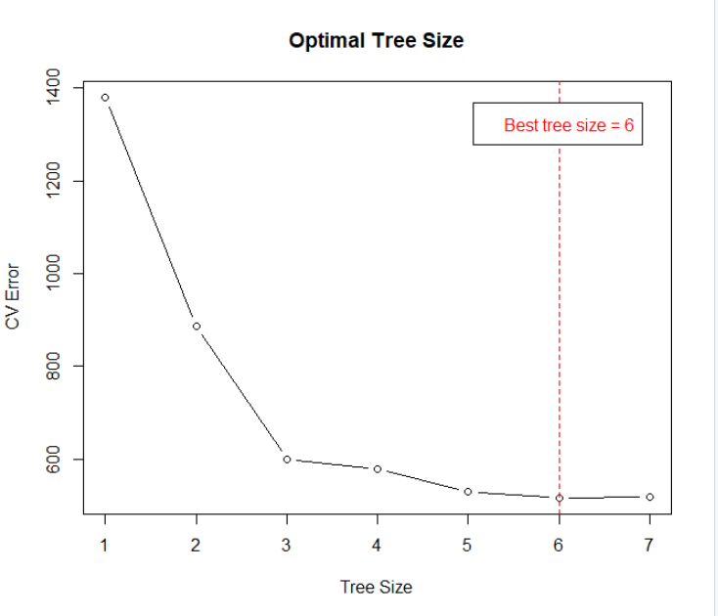
Regression Tree
MODEL BUILDING
Find optimal tree size
As we scaled the data, the specific number on the graph does not tell the whole story
Model MSE
Regression Tree 0.376
Notes:
Good ratings importance is expected as we have seen previously

Slide 14
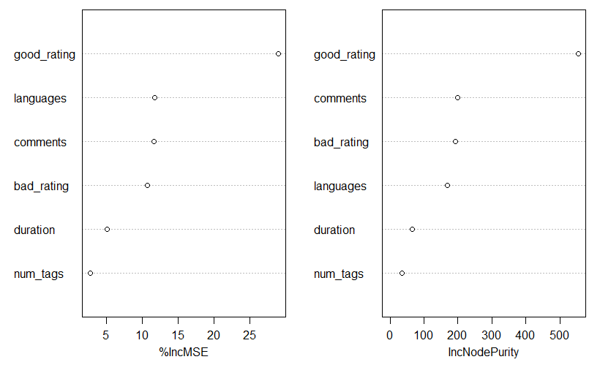
Random Forest
MODEL BUILDING
Variable Importance
We grew a 500-tree random forest:
Initial: mtry = p/3 = 2
Bagging: mtry = 6
Half-way: mtry = 4
Good ratings play a major role in prediction
Model MSE
Random Forest
(mtry = 6)
0.29

Slide 15
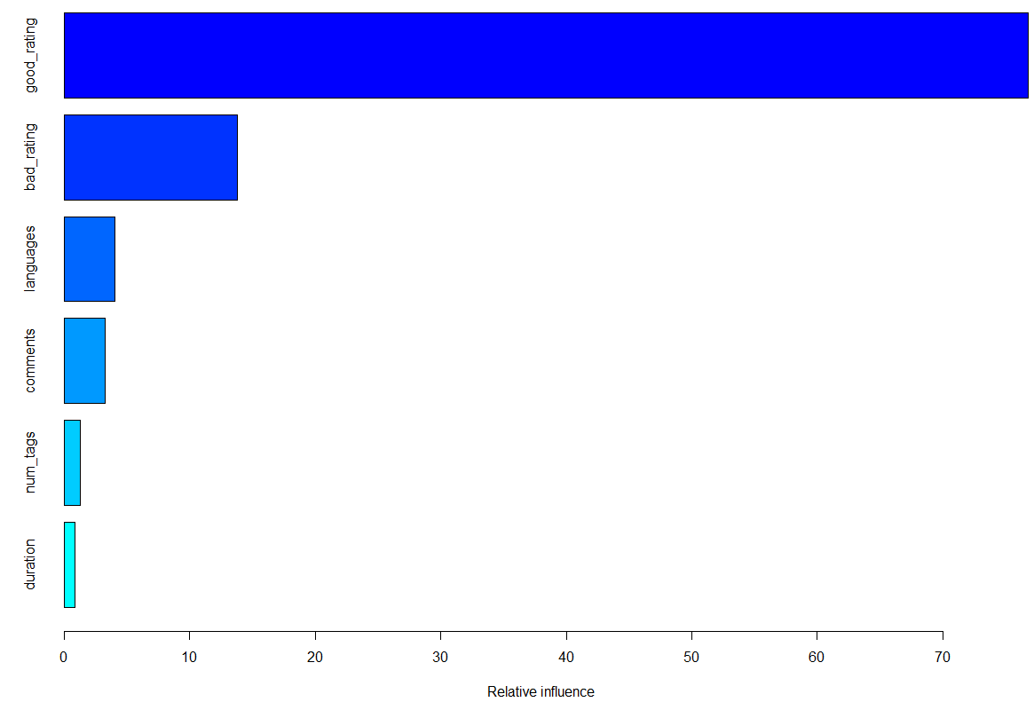
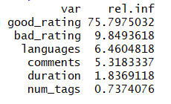
Boosting
MODEL BUILDING
We used Caret package to select the best tuning parameters.
The final model has mstop = 100, max depth = 3 and tuning parameter at a value of 0.1
Model MSE
Relative influence of factors
Boosting 0.336

Slide 16
THE RESULTS

Slide 17
Model Results
MODELS | PREDICTION ERROR
Classification CV | 0.43
Regression Tree | 0.376
Random Forest | 0.29
Boosting | 0.336

Slide 18
Conclusion
Promotion focus should be on videos with more good ratings
Future approach:
Exclude good ratings in analysis
Explore other predictors

